Slide 1
Hydrology
Rainfall Analysis (1)
Prof. Ke-Sheng Cheng
Department of Bioenvironmental Systems Engineering
National Taiwan UNiversity

Slide 2
Intensity-Duration-Frequency (IDF) Analysis
In many hydrologic design projects the first step is the determination of the rainfall event to be used.
The event is hypothetical, and is usually termed the design storm event. The most common approach of determining the design storm event involves a relationship between rainfall intensity (or depth), duration, and the frequency (or return period) appropriate for the facility and site location.

Slide 3
Steps for IDF analysis
When local rainfall data are available, IDF curves can be developed using frequency analysis. Steps for IDF analysis are:
  Select a design storm duration D, say D=24 hours.
  Collect the annual maximum rainfall depth of the selected duration from n years of historic data.
  Determine the probability distribution of the D-hr annual maximum rainfall. The mean and standard deviation of the D-hr annual maximum rainfall are estimated.

Slide 4


  Calculate the D-hr T-yr design storm depth XT by using the following frequency factor equation:
  where μ, σ and KT are mean, standard deviation and frequency factor, respectively. Note that the frequency factor is distribution-specific.
  Calculate the average intensity and repeat Steps 1 through 4 for various design storm durations.
  Construct the IDF curves.

Slide 5
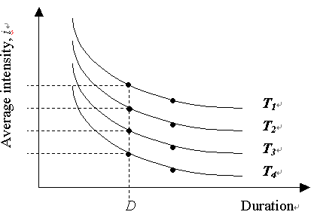

Slide 6
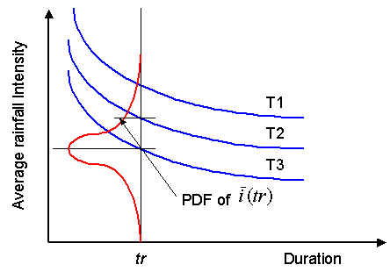
Random Variable Interpretation of IDF Curves

Slide 7
Methods of plotting positions can also be used to determine the design storm depths. Most of these methods are empirical. If n is the total number of values to be plotted and m is the rank of a value in a list ordered by descending magnitude, the exceedence probability of the mth largest value, x_{m}, is , for large n, shown in the following table.

Slide 8
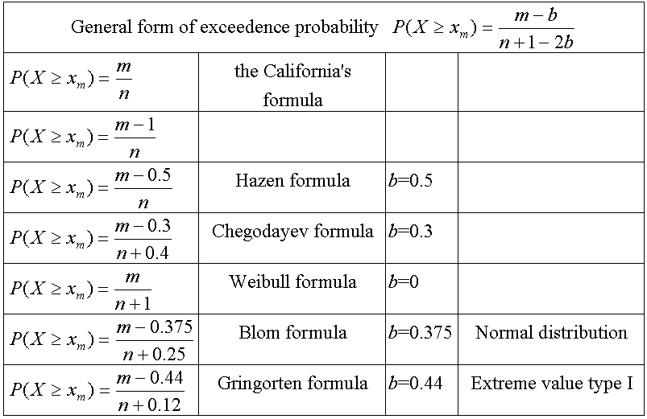
Plotting position formula

Slide 9
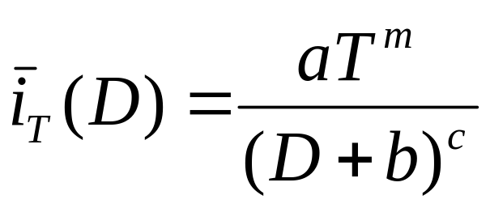
Horner’s equation
An IDF curve is NOT a time history of rainfall within a storm.
IDF curves are often fitted to Horner's equation

Slide 10
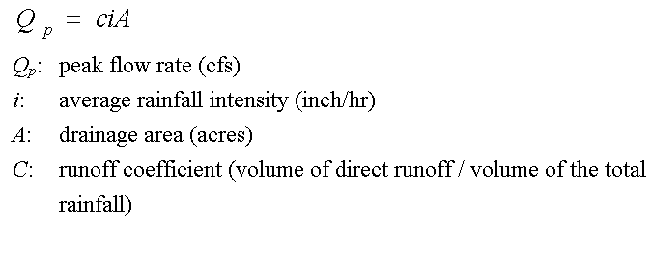
Peak flow calculation－the Rational method
Runoff coefficients for use in the rational formula (Table 15.1.1 of Applied Hydrology by Chow et al. )

Slide 11
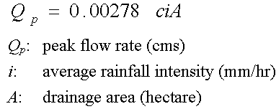
Rational formula in metric system

Slide 12
Assumptions of the rational method
Rainfall intensity is constant at all time.
Rainfall is uniformly distributed in space.
Storm duration is equal to or longer than the time of concentration tc.
Definition of the time of concentration tc
  The time for the runoff to become established and flow from the most remote part of the drainage area to drainage outlet.

Slide 13
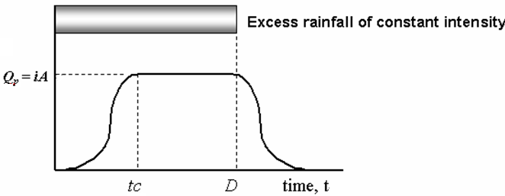
Rainfall－runoff relationship associated with the rational formula

Slide 14
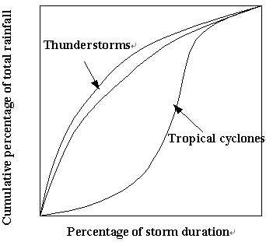
Storm Hyetographs
Hyetographs of typical storm types

Slide 15
The Role of A Hyetograph in Hydrologic Design
Rainfall frequency analysis
Design storm hyetograph
Rainfall-runoff modeling
Total rainfall depth
Time distribution of total rainfall
Runoff hydrograph

Slide 16
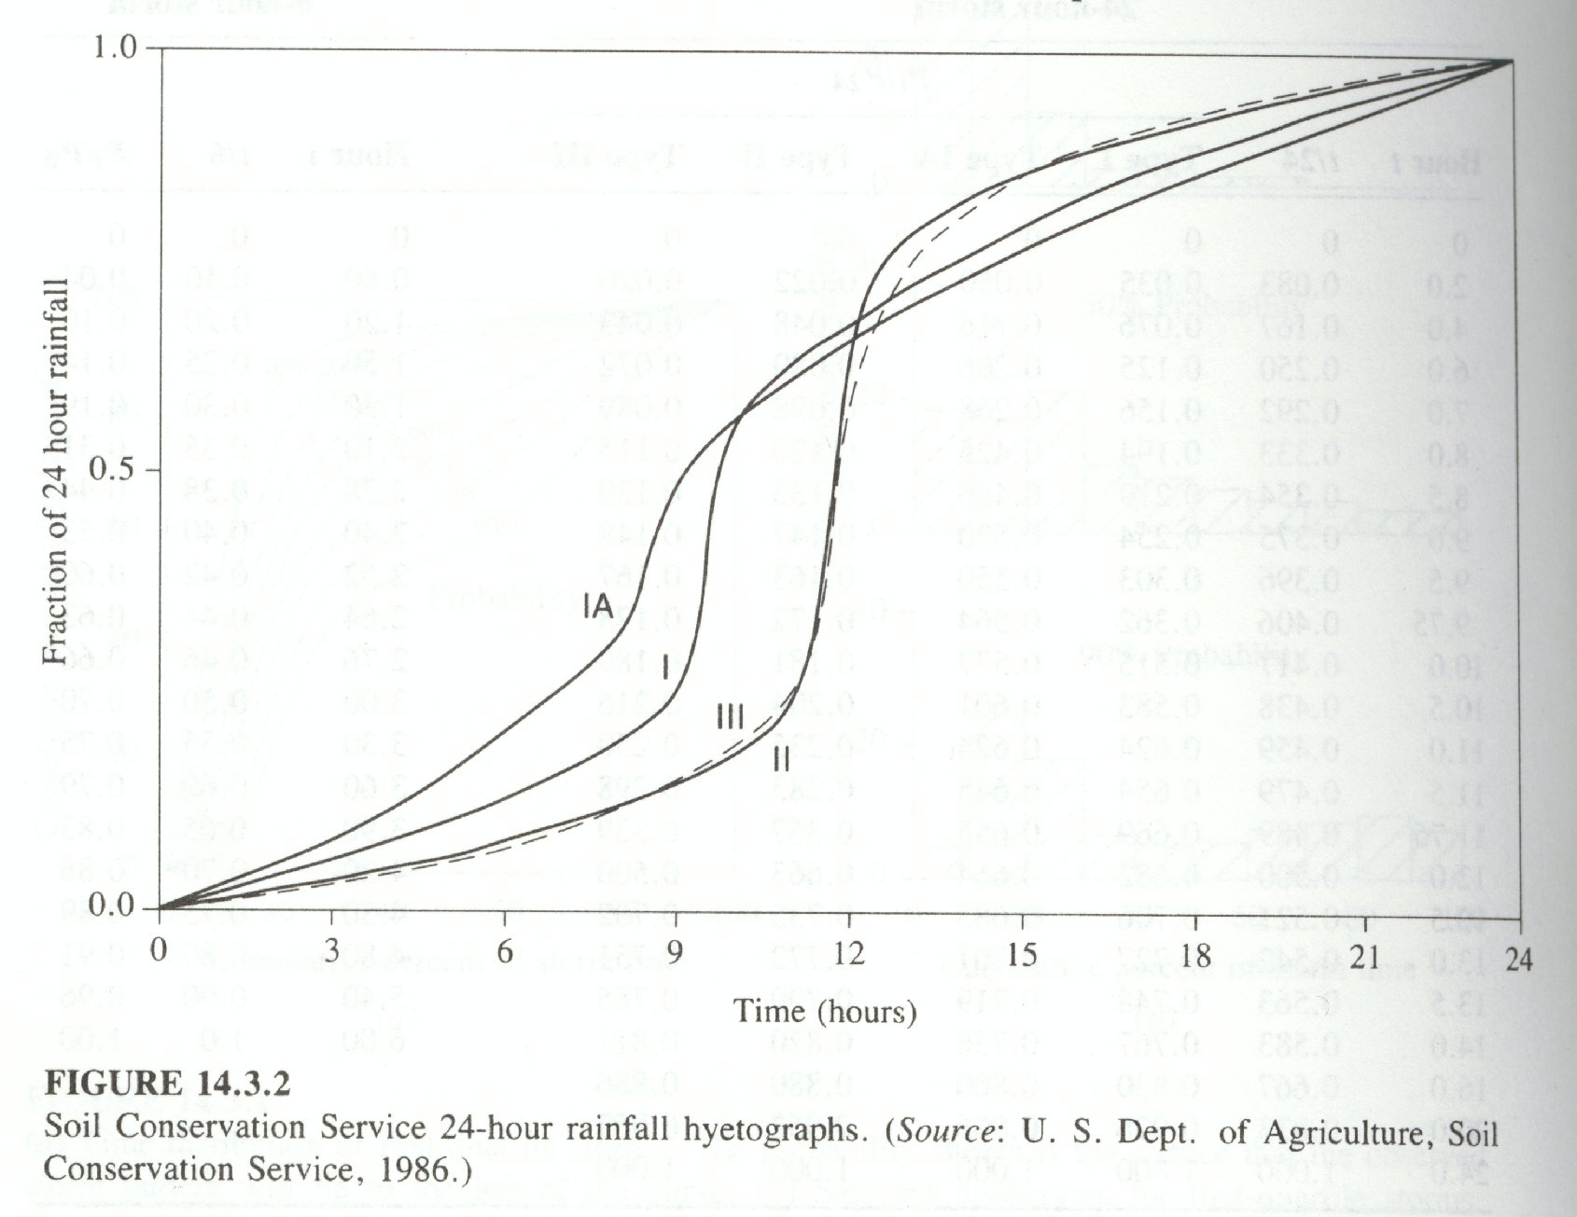
Design storm hyetograph
The SCS 24-hr design storm hyetographs

Slide 17
Design storm hyetographs
The alternating block model
The average rank Model
The triangular hyetograph model
The simple scaling Gauss-Markov model

Slide 18
The alternating block model
This model uses the intensity-duration-frequency (IDF) relationship to derive duration- and return-period-specific hyetographs (Chow et al., 1988). The hyetograph of a design storm of duration tr and return period T can be derived through the following steps:

Slide 19
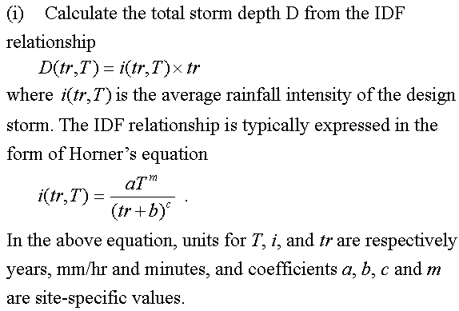

Slide 20
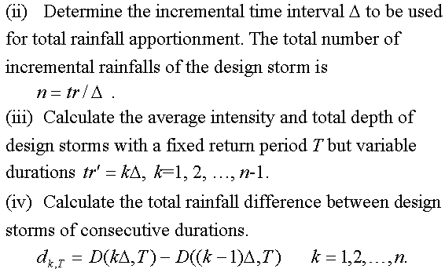

Slide 21
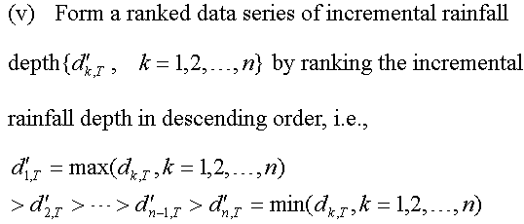

Slide 22
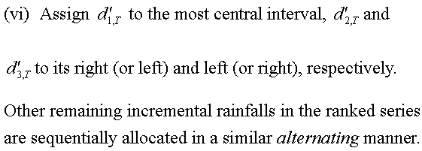
This model does not use rainfall data of real storm events and is duration and return period specific.

Slide 23
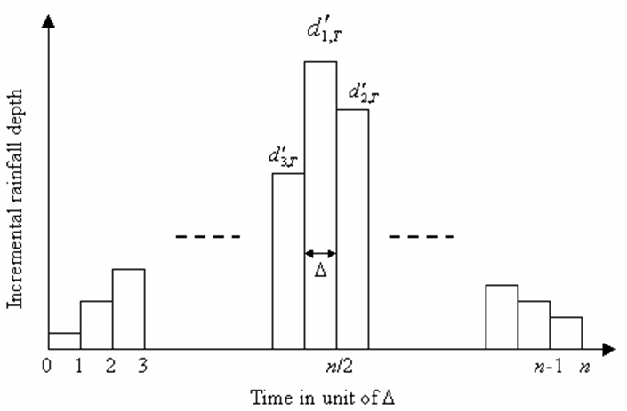
The alternating block hyetograph model

Slide 24
The Average Rank Model
Pilgrim and Cordery (1975) developed this model by considering the average rainfall- percentages of ranked rainfalls and the average rank of each time interval within a storm. Procedures for establishment of the hyetograph model are:

Slide 25
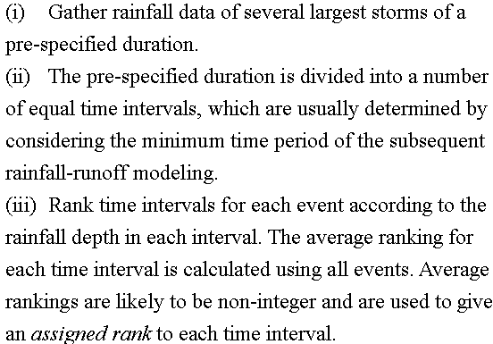

Slide 26
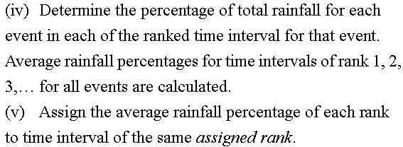
The average rank model is duration-specific and requires rainfall data of storm events of the same pre-specified duration. Since storm duration varies significantly, it may be difficult to gather enough storm events of the same duration.

Slide 27
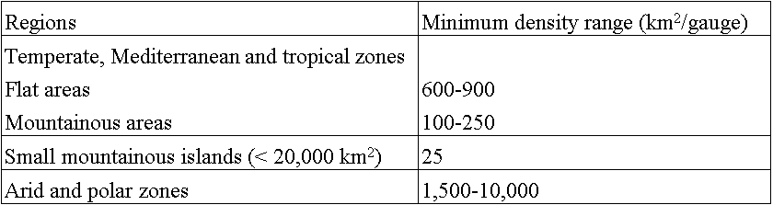
Raingauge Network
Minimum density of precipitation stations (WMO)
Ten percent of raingauge stations should be equipped with self-recording gauges to know the intensities of rainfall.

Slide 28
Adequacy of Raingauge Stations
The minimum number of raingauges N required to achieve a desired level of accuracy for the estimation of area-average rainfall can be determined by the following criteria:
  the coefficient of variation approach
  the statistical sampling approach

Slide 29
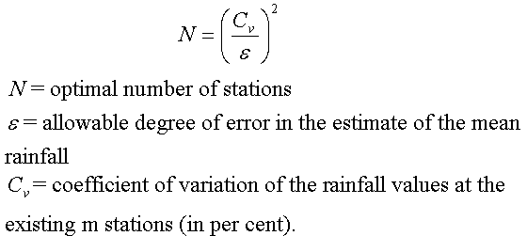
The coefficient of variation approach
If there are already some raingauge stations in a catchment, the optimal number of stations that should exist to have an assigned percentage of error in the estimation of mean rainfall is obtained by statistical analysis as:

Slide 30
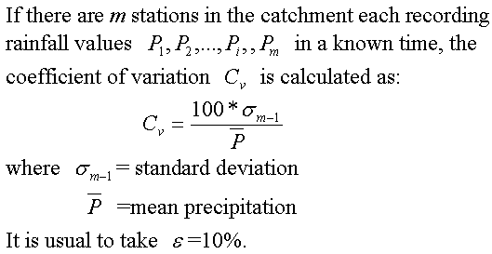

Slide 31
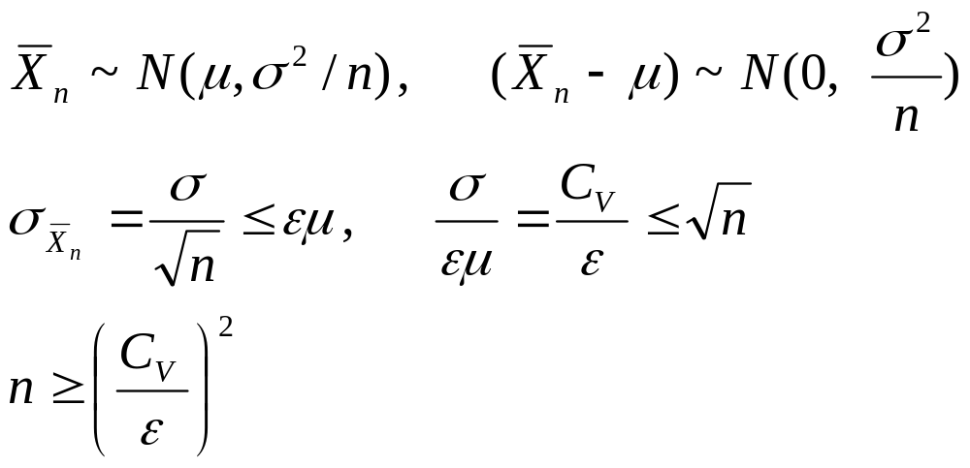
This approach is based on the idea that the standard deviation of the estimated average rainfall should not be larger than a specified percentage of the areal average rainfall.

Slide 32
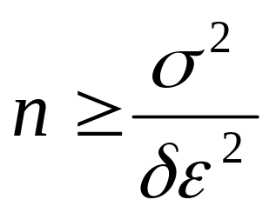
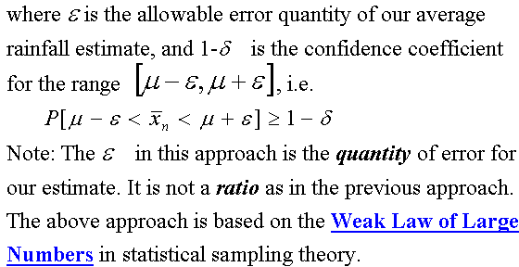
The statistical sampling approach

Slide 33

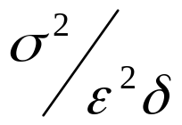
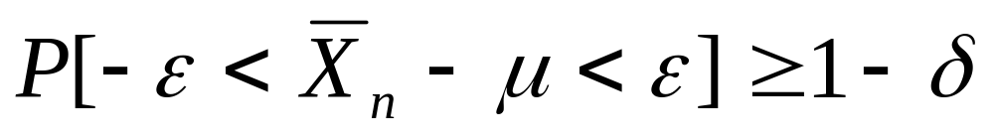
Weak Law of Large Numbers (WLLN)
Let f(．) be a density with mean μ and variance σ², and let be the sample mean of a random sample of size n from f(．). Let εand δ be any two specified numbers satisfying ε>0 and 0<δ<1. If n is any integer greater than , then

Slide 34
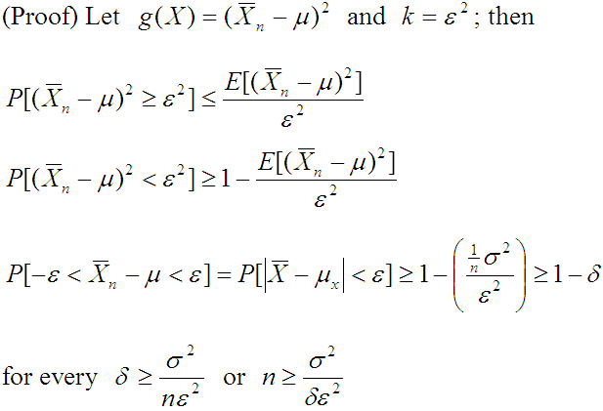

Slide 35
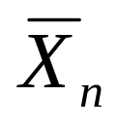
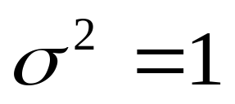
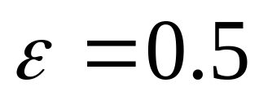
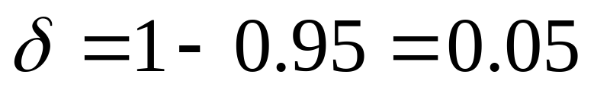
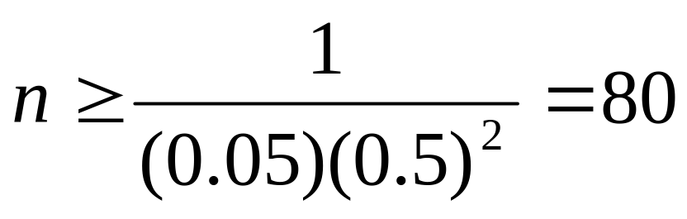
(Example) Suppose that some distribution with an unknown mean has variance equal to 1. How large a random sample must be taken in order that the probability will be at least 0.95 that the sample mean will lie within 0.5 of the population mean?

Slide 36
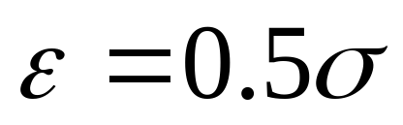
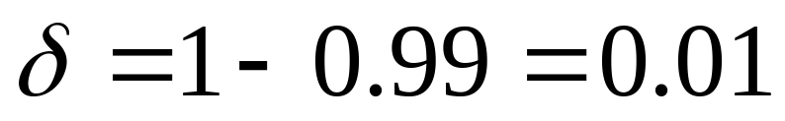
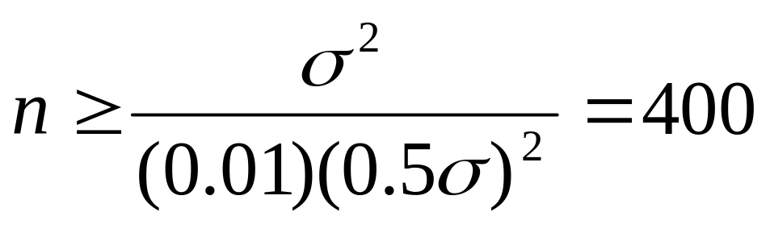
(Example) How large a random sample must be taken in order that you are 99% certain that is within 0.5σ of μ?

Slide 37
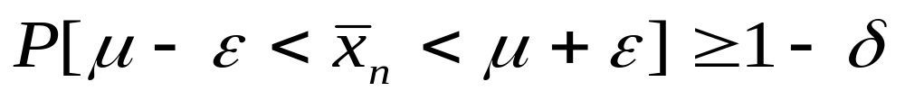
Raingauge network design
Assuming there are already some raingauge stations in a catchment, and we are interested in determining the optimal number of stations that should exist to achieve a desired accuracy in the estimation of mean rainfall.
Two approaches
  (1) The sample standard deviation should not exceed a certain portion of the population mean.
  (2)

Slide 38

Criterion 1
Standard deviation of the sample mean should not exceed a certain portion of the population mean.

Slide 39
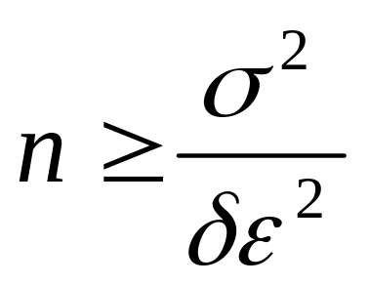
Criterion 2
From the weak law of large numbers,

Slide 40
Preparation of data
Before using the rainfall records of a station, it is necessary to firstly check the data for continuity and consistency.
The continuity of a record may be broken with missing data due to many reasons such as damage or fault in a raingauge during a period.
Missing data can be estimated using data of neighboring stations. In these calculations the normal rainfall is used as a standard for comparison.

Slide 41
The normal rainfall is the average value of rainfall at a particular date, month or year over a specified 30-year period. The 30-year normals are recomputed every decade. Thus the term normal annual precipitation at station A means the average annual precipitation at A based on a specified 30-years of record.

Slide 42
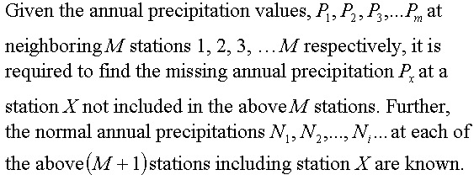
Estimation of missing data

Slide 43
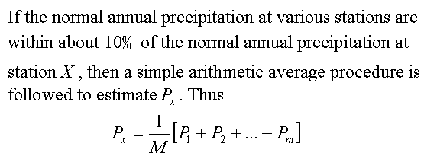

Slide 44
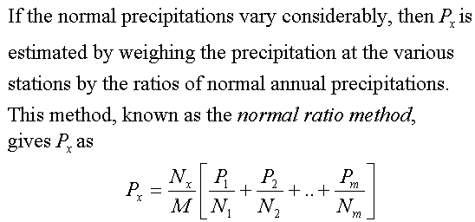

Slide 45
Test for record consistency
Some of the common causes for inconsistency of record include:
Shifting of a raingauge station to a new location,
The neighborhood of the station undergoing a marked change.

Slide 46
Double-mass curve technique
The checking for inconsistency of a record is done by the double-mass curve technique. This technique is based on the principle that when each recorded data comes from the same parent population, they are consistent.
  A group of n (usually 5 to 10) base stations in the neighborhood of the problem station X is selected.
  Annual (or monthly mean) rainfall data of station X and also the average rainfall of the group of base stations covering a long period is arranged in the reverse chronological order (i.e. the latest record as the first entry and the oldest record as the last entry in the list).

Slide 47
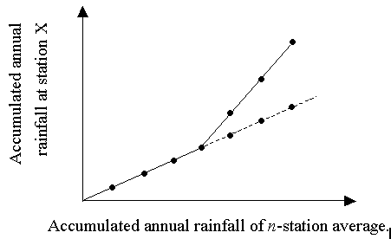

Slide 48
It is apparent that the more homogeneous the base station records are, the more accurate will be the corrected values at station X. A change in slope is normally taken as significant only where it persists for more than five years.

Slide 49
Depth-Area-Duration Curve
The technique of depth-area-duration analysis (DAD) determines primarily the maximum falls for different durations over a range of areas. The data required for a DAD analysis are shown in the following figure.

Slide 50
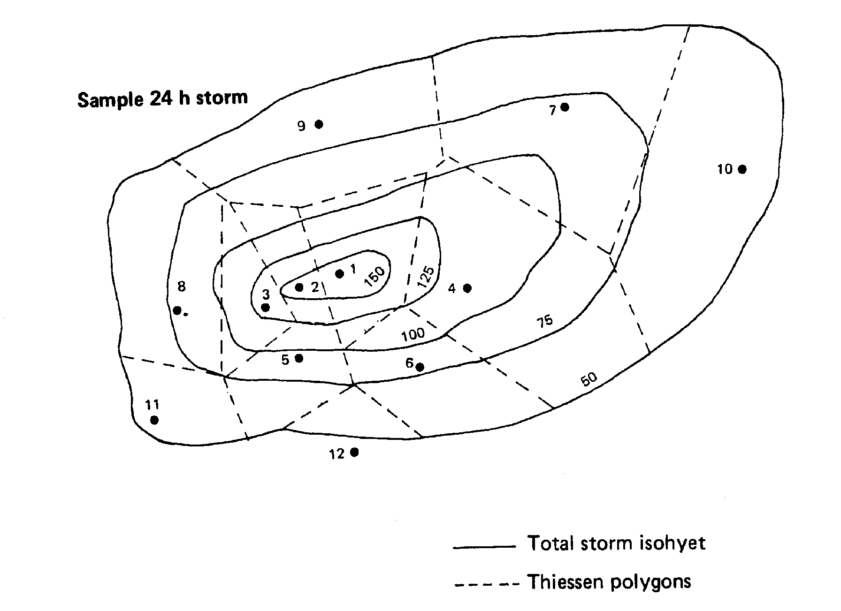

Slide 51
To demonstrate the method, a storm lasting 24h is chosen and the isohyets of the total storm are drawn related to the measurements from 12 recording rain gauge stations.
The accumulated rainfalls at each station for four 6-h periods are given in the table.
To provide area weightings to the gauge values, Thiessen polygons are drawn around the rainfall stations over the isohytal pattern.

Slide 52
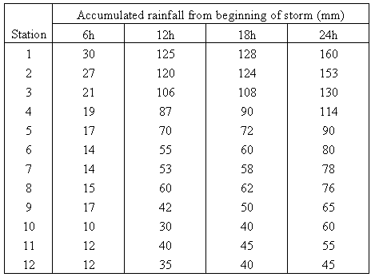

Slide 53
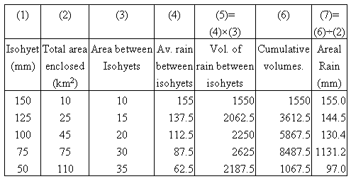

Slide 54
Step-by-step procedures for drawing DAD curves
First, the areal rainfall depths over the enclosing isohytal areas are determined for the total storm.
The duration computations then proceed as in the following table, where the area enclosed (10km²) by the 150mm isohyet is considered first. The areal rainfall over the 10km² for the whole storm is 155mm.

Slide 55
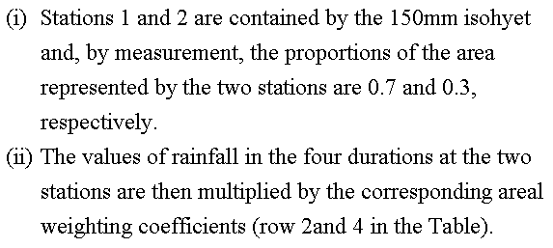

Slide 56
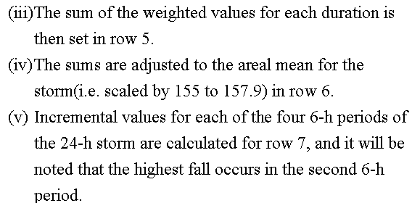

Slide 57
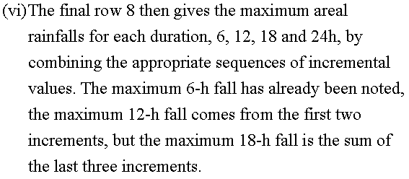

Slide 58
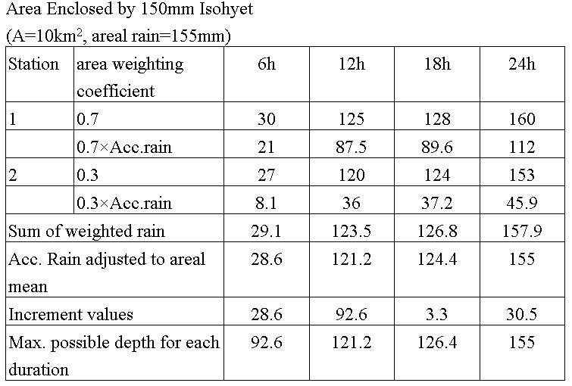

Slide 59
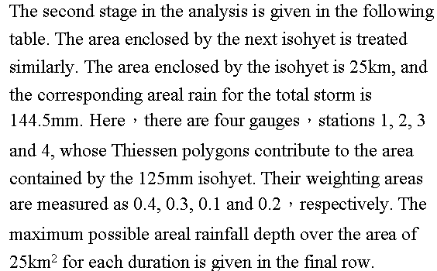

Slide 60
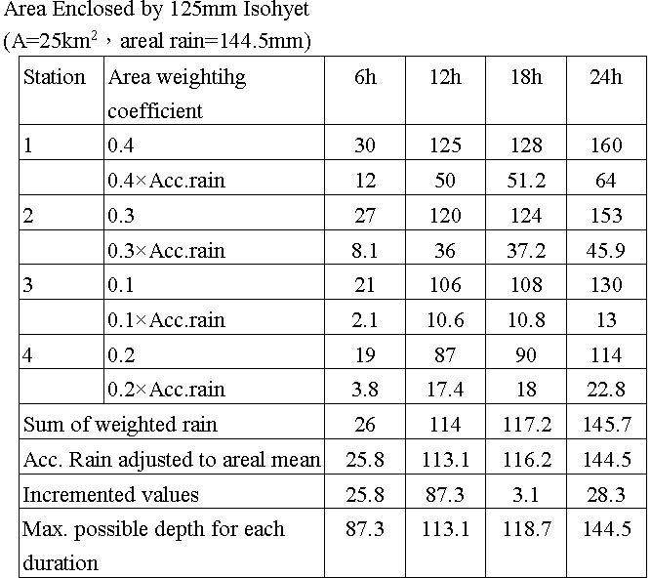

Slide 61
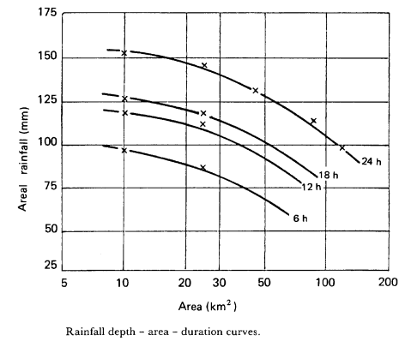
The computations are continued by repeating the method for the areas enclosed by all the isohyets.

